Slide 1
Sukhwinder Singh
Portfolio

Slide 2
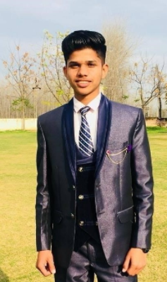
Hi, I am Sukhwinder Singh

Slide 3
About Me
I am montreal based web designer and developer. I have done diploma in computer and web design from CDI college montreal downtown campus.
I have great knowledge of frontend and backend languages. In this college I have completed 24 modules which are based on web design and development.
I have great experience with Server apache and PHPmyAdmin.
In this course I gained web marketing skills like SEO and SMM as well.
I have designed several projects in this course which are based on Photoshop, illustrator, Html, Css3

Slide 4

Poster Design
I designed this poster in Photoshop, I use shapes, pen tool and texts.

Slide 5

Mockup Design
Rental Homes Mockup designed in Photoshop

Slide 6

Logo Design
I designed this monogram in Illustrator 2020

Slide 7
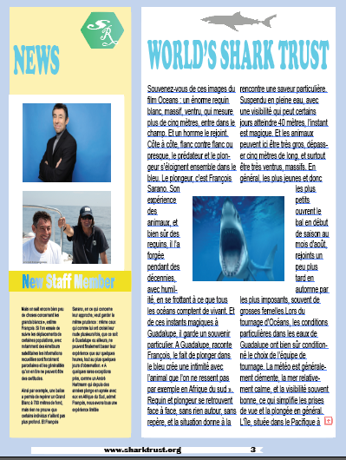
Magzine Design
In illustrator module I designed text wrapped magazine with typographical concept

Slide 8
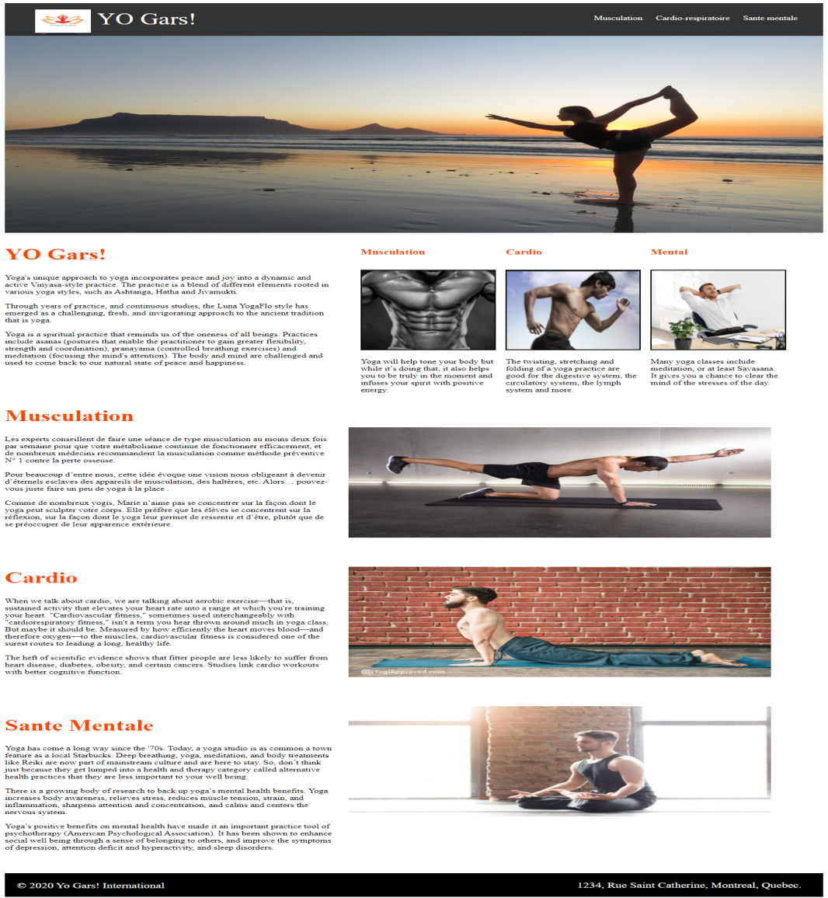
Yo Gars
Language HTML, CSS and Animation with JS

Slide 9
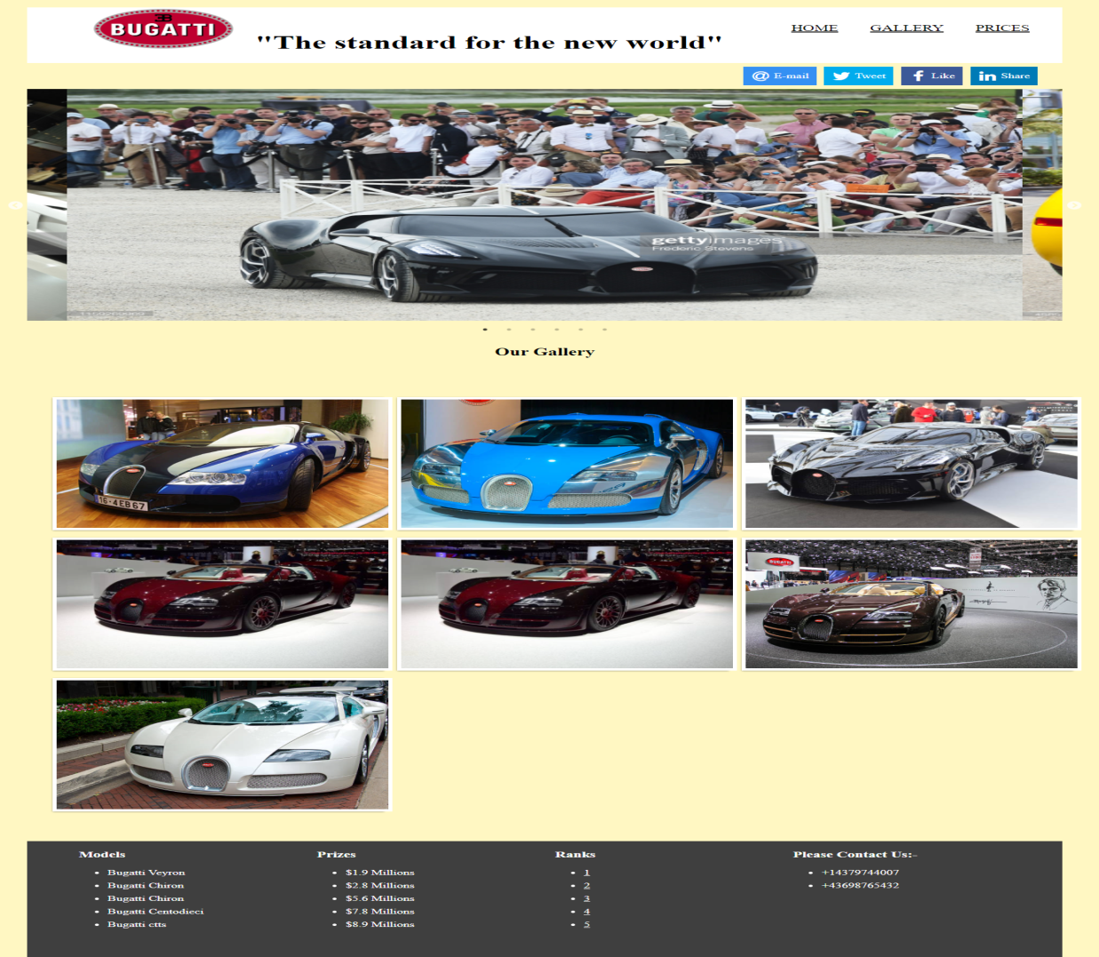
Bugati
I use Bootstrap 9 Grid Column to design this template

Slide 10
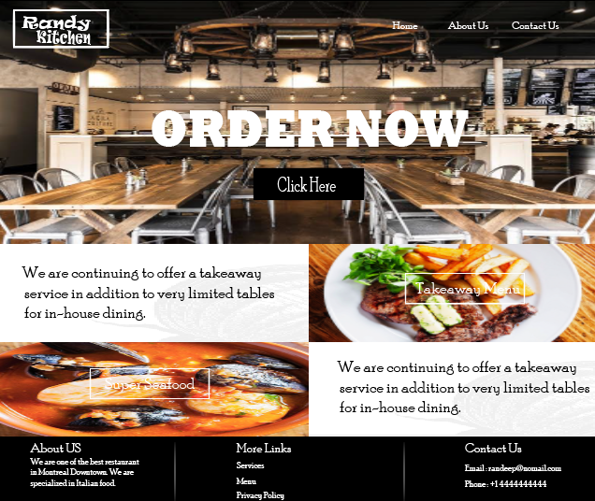
Randeep Kitchen
I use Bootstrap carousal, Accordian and bootstrap modal in this project.

Slide 11
Hope you like my Work
Thank you

